Slide 1

Know the Score
A review of the quality of care provided to patients aged over
16 years with a new diagnosis of pulmonary embolism.
Principal recommendations
Notes:
Presenter’s notes:
This presentation can be used to present the principal recommendations from the report Know the Score. This looked at care provided to patients aged over 16 with a new diagnosis of pulmonary embolism. The study covered the whole of the UK including off-shore islands.
It will only cover the principal recommendations and the full set of recommendations can be found in the report.
More information can be found at www.ncepod.org.uk.

Slide 2
The study
A review of the quality of care provided to patients aged over 16 years with a new diagnosis of pulmonary embolism.
Organisational questionnaire
Clinician questionnaire
Case note review
Notes:
Presenter’s notes:
The study described in this report aimed to identify and explore remediable factors in the process of care for patients with a new diagnosis of PE who either presented to hospital with symptoms of PE or who developed PE whilst in hospital being treated for another condition and who were cared for
as outpatients and those who were admitted to hospital.
Case notes are reviewed by a multidisciplinary group of clinicians comprising consultants, trainees and clinical nurse specialists from: cardiology, anaesthesia, intensive care medicine, acute medicine, emergency medicine, respiratory medicine, neurosurgery and radiology.

Slide 3
Study population
All patients aged 16 years and older who presented to hospital with symptoms of a PE or who developed PE as an inpatient (using ICD10 codes I26.0 and I26.9) between 1st July 2017 and 31st August 2017 inclusive
Ambulatory care/same day emergency patients and patients admitted to hospital were included in the study
Notes:
Presenter’s notes:
All patients aged 16 years and older who presented to hospital with symptoms of a PE or who developed PE as an inpatient (using ICD10 codes I26.0 and I26.9) between 1st July 2017 and 31st August 2017 inclusive
Both ambulatory care/same day emergency patients and patients admitted to hospital were included in the study
Selection of patients into the study was biased towards those more likely to have a severe PE. This was done by dividing patients into 3 categories and where the number of cases allowed, two patients from each category were included per hospital:
1) Primary coding diagnosis of PE with a length of stay ≤ 3 days
2) Any coding of PE with a length of stay > 3 days
3) Primary coding diagnosis of PE, admitted to critical care and/or who died with any length of stay

Slide 4
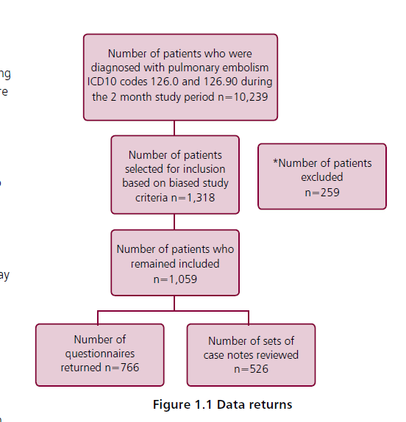
Study sample
Notes:
Presenter’s notes:
Out of around 10,000 patients, 1,318 were selected for case note review. 259 of these were excluded for various reasons. 526 sets of case notes were received and peer reviewed. 766 clinician questionnaires were completed by the named consultant caring for the patient at the time of their inpatient/ambulatory care discharge.
This Figure shows the types of patient, in terms of outcome, length of stay and diagnosed position of PE whose cases were reviewed by the case reviewers, compared to the overall dataset (all patients). This demonstrates the bias of the peer review sample towards patients who had a worse outcome/longer length of stay.

Slide 5
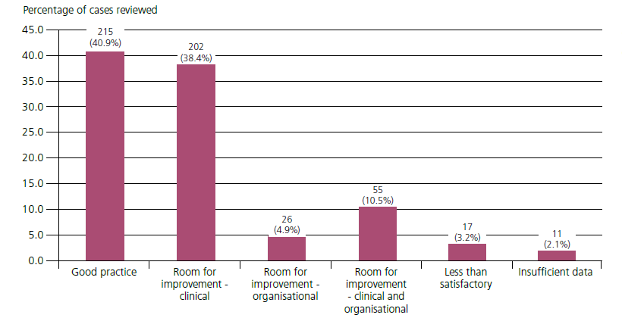
Overall assessment of care
Figure 10.2 Overall assessment of care
Notes:
Presenter’s notes:
Case note reviewers assessed the overall quality of care for each case. Just over 40% were felt to demonstrate good practice, whilst another ~ 40% showed room for improvement in clinical care.
A very small number were considered to be less than satisfactory.

Slide 6
Key messages (1)
Delays were recorded throughout the process of care with recognition, investigations and treatment the commonest reasons
Where there might be a delay to the diagnosis of acute PE anticoagulation should be commenced
Upon diagnosis of PE, a severity assessment of PE needs to be undertaken to treat patients effectively
Notes:
Presenter’s notes:
Key messages from the report are:
The case reviewers reports delays throughout the care pathway for patients with PE. The commonest reasons for delay were recognition, investigations and treatment.
The primary treatment for PE is anticoagulation. It is imperative that this is started as soon as possible. Where there might be a delay to the diagnosis of acute PE anticoagulation should be commenced.
Once PE has been diagnosed an assessment of PE severity needs to be undertaken in order to treat patients effectively. Validated scoring systems such as PESI or Hestia could be used.

Slide 7
Key messages (2)
Ambulatory care pathways should be considered for PE patients with low risk of adverse outcomes
Patients should receive the necessary information to make an informed choice about taking anticoagulation
Routine outpatient follow-up should be arranged for patients following a PE diagnosis
Notes:
Presenter’s notes:
Ambulatory care has recently become a recognised pathway for PE management in those patients with low-risk of adverse outcomes. The rationale for selecting or excluding it should be documented in the case notes.
Patients should receive all the information they need to make an informed choice, particularly with respect to taking anticoagulation.
Routine outpatient follow-up should be arranged for patient following a PE diagnosis. The discharge letter should include the likely cause of the PE, a decision on the duration of anticoagulation and an assessment of whether the PE was provoked or unprovoked.

Slide 8
Principal recommendation 1
Give an interim dose of anticoagulant to patients suspected of having and acute pulmonary embolism (unless contraindicated) when confirmation of the diagnosis is expected to be delayed by more than one hour. The anticoagulant selected, and its dose, should be personalised to the patient.
.
Notes:
Presenter’s notes:
This recommendation is aimed at all clinicians, and the Quality Improvement Lead to implement at a local level.
The recommendation is in line with NICE QS29, 2013. https://www.nice.org.uk/guidance/QS29

Slide 9
Principal recommendation 2
Document the severity of acute pulmonary embolism immediately after the confirmation of diagnosis. Severity should be assessed using a validated standardised tool, such as 'PESI' or 'sPESI'. This score should then be considered when deciding on the level of inpatient or ambulatory care.
Notes:
Presenter’s notes:
This recommendation is aimed at all clinicians who treat patients with pulmonary embolism.
The use of validated standardised tool such as ‘PESI’ or ‘sPESI’ is encouraged to assess severity after the confirmation of diagnosis. The score should then be considered when deciding on the level of inpatient or ambulatory care.

Slide 10
Principal recommendation 3
Standardise CT pulmonary angiogram reporting. The proforma should include the presence or absence of right ventricular strain. The completion of these proformas should be audited locally to monitor compliance and drive quality improvement.
Notes:
Presenter’s notes:
This recommendation is aimed at the Clinical Lead for Radiology and the Quality Improvement Lead.

Slide 11
Principal recommendation 4
Look for indicators of massive (high-risk) or sub-massive (intermediate-risk) pulmonary embolism, in addition to calculating the severity of acute pulmonary embolism in the form of:
i. Haemodynamic instability (clinical)
ii. Right heart strain (imaging)
iii. Elevated troponin or BNP (biochemical)
Escalate promptly based on local guidance and document in the case notes.
Notes:
Presenter’s notes:
This recommendation is aimed at all clinicians who treat patients with pulmonary embolism.
In addition to calculating the severity of acute pulmonary embolism, clinicians should also look for indicators of massive (high-risk) or sub-massive (intermediate-risk):
i. Haemodynamic instability (clinical)
ii. Right heart strain (imaging)
iii. Elevated troponin or BNP (biochemical)
Hospitals should have a guidelines in place for the diagnosis and management of PE and to assess the severity of PE.

Slide 12
Principal recommendation 5
Assess patients suspected of having an acute pulmonary embolism for their suitability for ambulatory care and document the rationale for selecting or excluding it in the case notes.
Notes:
Presenter’s notes:
This recommendation is aimed at all clinicians who treat patients with pulmonary embolism.
Ambulatory care should be considered as a treatment option for patients with PE, when appropriate. The rationale for selecting or excluding it should be documented in the case notes.

Slide 13
Principal recommendation 6
Provide every patient with an acute pulmonary embolism with a follow-up plan, patient information leaflet and, at discharge, a discharge letter which should include:
i. The likely cause of the pulmonary embolism
ii. Whether it was provoked or unprovoked
iii. Details of follow-up appointment(s)
iv. Any further investigations required
v. Details of anticoagulant prescribed and its duration, in line with NICE CG144
Notes:
Presenter’s notes:
(All Clinicians, Service Users, General Practitioners)

Slide 14
Discussion
Is there a guideline in place for the treatment of PE patients via ambulatory care?
Are PE severity assessment tools being used? Are the scores being documented in the notes?
Is there a standard format to the CTPA report? Is the presence or absence of right ventricular strain being recorded?
Is there a robust system in place to alert clinicians of changes to radiological reports?

Slide 15
Know the Score
Full report, summary and implementation tools are be found at
www.ncepod.org.uk/2019pe.html
Notes:
www.ncepod.org.uk/2019pe.html

